Slide 1
CSE460: VLSI Design
Lecture 3

Slide 2
CMOS Logic

Slide 3
Contents
Silicon lattice structure
p-type and n-type semiconductors, p-n junction diode
nMOS and pMOS transistors
Transistors as switches
Basic logic gate review
CMOS gate structure
Pull-up network (PUN) and pull-down network (PDN)
Series and parallel PUN & PDN networks
CMOS implementation of AOI, OAI and other logic gates

Slide 4
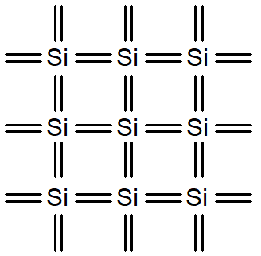
Silicon Lattice
Silicon is a semiconductor
Transistors are built on a silicon substrate
Silicon is a Group IV material
Si (16) -> 1s² 2s²2p⁶ 3s²3p²
Forms crystal lattice with covalent bonds to four neighbors
Pure silicon has no free carriers and conducts poorly
How to increase its conductivity?

Slide 5
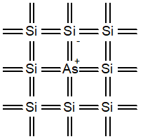
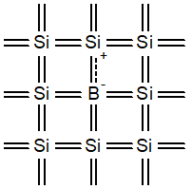
Doped (Impure) Silicon
How to increase the conductivity of a pure semiconductor (usually Group IV materials)?
Answer: by adding impurity! (dopants)
Adding dopants increases the conductivity
Group V dopants: provides free “electron” to the pure semiconductor (Ex: Arsenic)
Called the n-type semiconductor afterwards
Group III dopants: provides free “holes” to the pure semiconductor (Ex: Boron)
Called the p-type semiconductor afterwards

Slide 6
Concept Review
n-type semiconductor
Carrier: electrons
Net electrical charge of the material stays the same (electrically neutral)
Difference with pure semiconductor: it has more free electrons, even after forming bonds with the neighboring atoms
Free electrons increase conductivity
p-type semiconductor
Carrier: holes (absence of electrons)
Net electrical charge of the material stays the same (electrically neutral)
Difference with pure semiconductor: it has empty electron spaces (called holes) in certain bonds with the neighbouring atoms
Electrons from neighbouring bonds try to fill up the empty spaces by creating a flow of electrons, hence increasing the conductivity

Slide 7
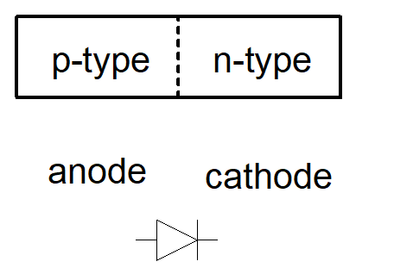
Concept Review
A junction between p-type and n-type semiconductor forms a diode.
Current flows only in one direction
p-type to n-type, n-type to p-type

Slide 8
Electrical Voltage ⇔ Logic Conversion
V_{DD} = Logical High (1)
GND = Logical Low (0)
V_{DD} = 5 V, 3.3 V, 2.5 V, 1.8 V, 1.5 V, 1.2 V, 1.0 V, … (electrical voltage)
GND = 0 V (electrical voltage)
V_{DD} has decreased in modern processes
High V_{DD} would damage modern tiny transistors
Lower V_{DD} saves power

Slide 9
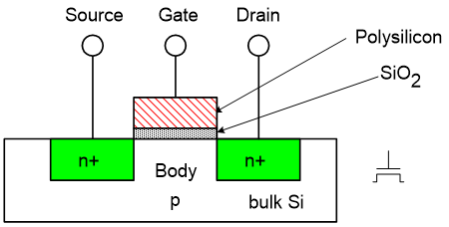
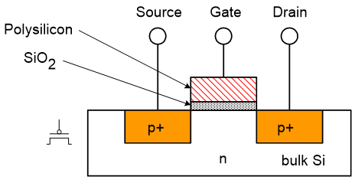
MOS Transistor
Four terminals: gate, source, drain, body
gate, source, body -> conductors, SiO₂ (oxide) -> insulator
source and drain are identical, can be used interchangeably, no difference in construction
Body is tied to the source: functionally a 3 terminal device
Depending on the voltage applied to the gate terminal, source and drain are either electrically connected or disconnected

Slide 10
nMOS Transistor
Low voltage (GND) applied to the gate: TRANSISTOR is OFF
source and drain are disconnected (no channel between them)
no current flows, transistor is OFF
High voltage (V_{DD}) applied to the gate: TRANSISTOR is ON
source and drain are connected by an n-channel, right under the gate oxide (SiO₂)
current flows from drain to source, transistor is ON
details on the working mechanism: later in this course!

Slide 11
pMOS Transistor
Low voltage (GND) applied to the gate: TRANSISTOR is ON
source and drain are connected by a p-channel, right under the gate oxide (SiO₂)
current flows from source to drain (opposite direction of nMOS), transistor is ON
details on the working mechanism: later in this course!
High voltage (V_{DD}) applied to the gate: TRANSISTOR is OFF
source and drain are disconnected (no channel between them)
no current flows, transistor is OFF

Slide 12
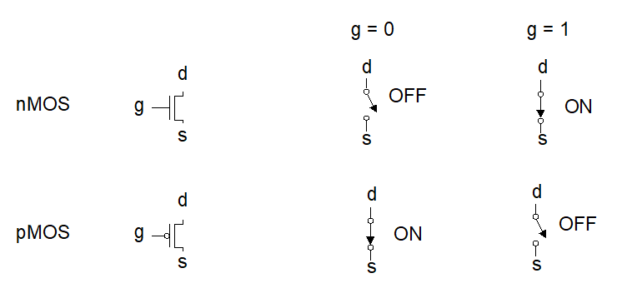
MOS Transistors as Switches
Electrically controlled switches
Voltage at gate controls path from source to drain

Slide 13
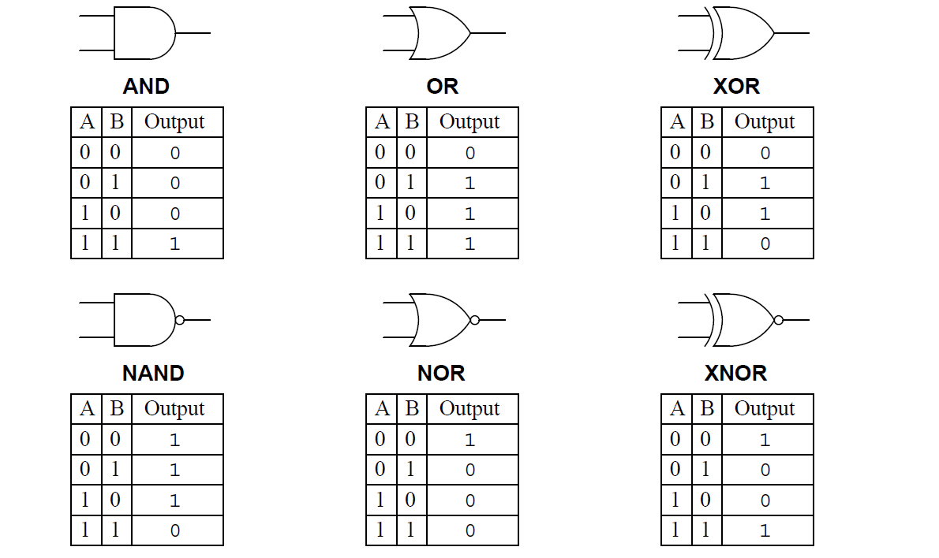
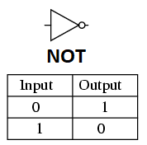
Basic logic gates

Slide 14
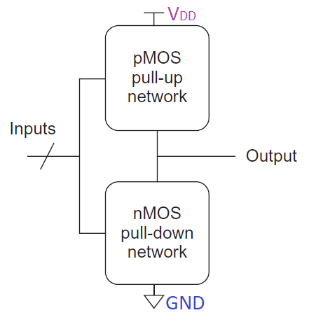
CMOS
CMOS can be used to build both simple and compound logic gates
Consists of 2 networks
pMOS pull-up network
nMOS pull-down network
pMOS & nMOS both used in the same structure -> CMOS

Slide 15
CMOS
Depending on inputs the networks can be ON or OFF
Network ON: Network is conducting electricity
Network OFF: Network is not conducting electricity
Depending on the inputs, 4 possible combinations of the 2 networks are possible:
 | Pull-up OFF | Pull-up ON
Pull-down OFF | Output = Z (float) | Output = 1 (High)
Pull-down ON | Output = 0 (Low) | Output = X (indeterminate)

Slide 16
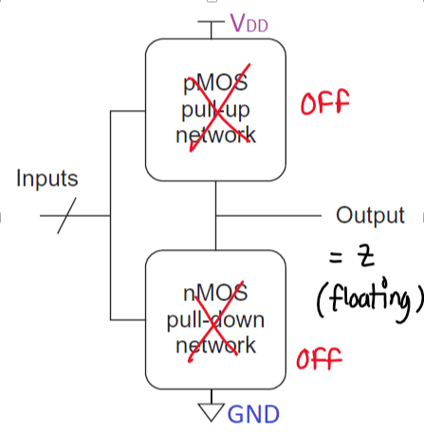
CMOS gate structure
Pull-up: OFF
Pull-down: OFF
Output is very high impedance/Z/floating/no connection
Useful when we want to detach some part of our circuit
 | Pull-up OFF | Pull-up ON
Pull-down OFF | Output = Z (float) | Output = 1 (High)
Pull-down ON | Output = 0 (Low) | Output = X (indeterminate)

Slide 17
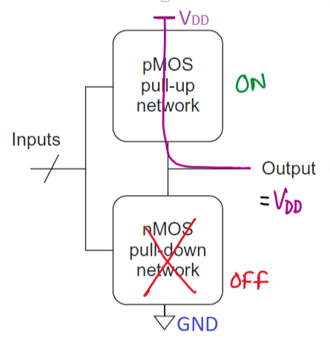
CMOS gate structure
Pull-up: ON
Pull-down: OFF
Output is pulled-up to V_{DD}
Useful when we want to output logical high (1)
 | Pull-up OFF | Pull-up ON
Pull-down OFF | Output = Z (float) | Output = 1 (High)
Pull-down ON | Output = 0 (Low) | Output = X (indeterminate)

Slide 18
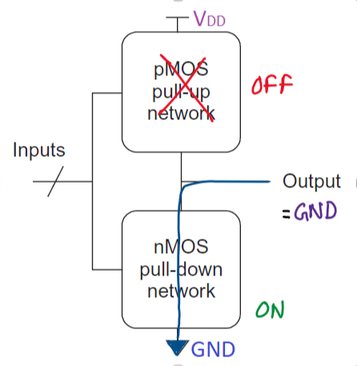
CMOS gate structure
Pull-up: OFF
Pull-down: ON
Output is pulled-down to GND
Useful when we want to output logical low (0)
 | Pull-up OFF | Pull-up ON
Pull-down OFF | Output = Z (float) | Output = 1 (High)
Pull-down ON | Output = 0 (Low) | Output = X (indeterminate)

Slide 19
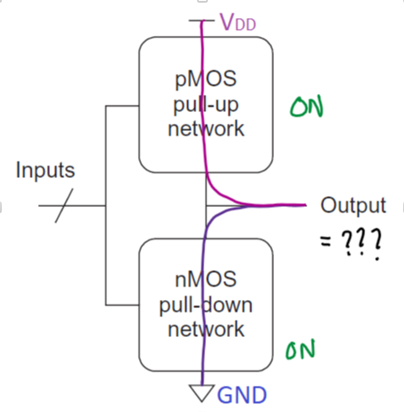
CMOS gate structure
Pull-up: ON
Pull-down: ON
Output is indeterminate
somewhere between V_{DD} and GND, we don’t know for sure
Usually a faulty condition
 | Pull-up OFF | Pull-up ON
Pull-down OFF | Output = Z (float) | Output = 1 (High)
Pull-down ON | Output = 0 (Low) | Output = X (indeterminate)

Slide 20
Pull-up & Pull-down Networks
Simplest pull-up network: a single pMOS
Complex pull-up network can be build from different series and parallel combinations of pMOS transistors
Simplest pull-down network: a single nMOS
Complex pull-down network can be build from different series and parallel combinations of nMOS transistors

Slide 21
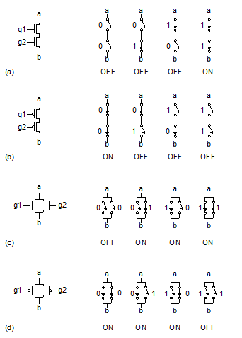
Series and Parallel Networks: Simple case
Pull-up network: a single pMOS
High voltage at gate input: OFF
Low voltage at gate input: ON
Pull-down network: a single nMOS
High voltage at gate input: ON
Low voltage at gate input: OFF
Series combination of networks
Every network must be ON to make the whole network conducting (figure: a, b)
Parallel combination of networks
At least one network must be ON to make the whole network conducting (figure: c, d)

Slide 22
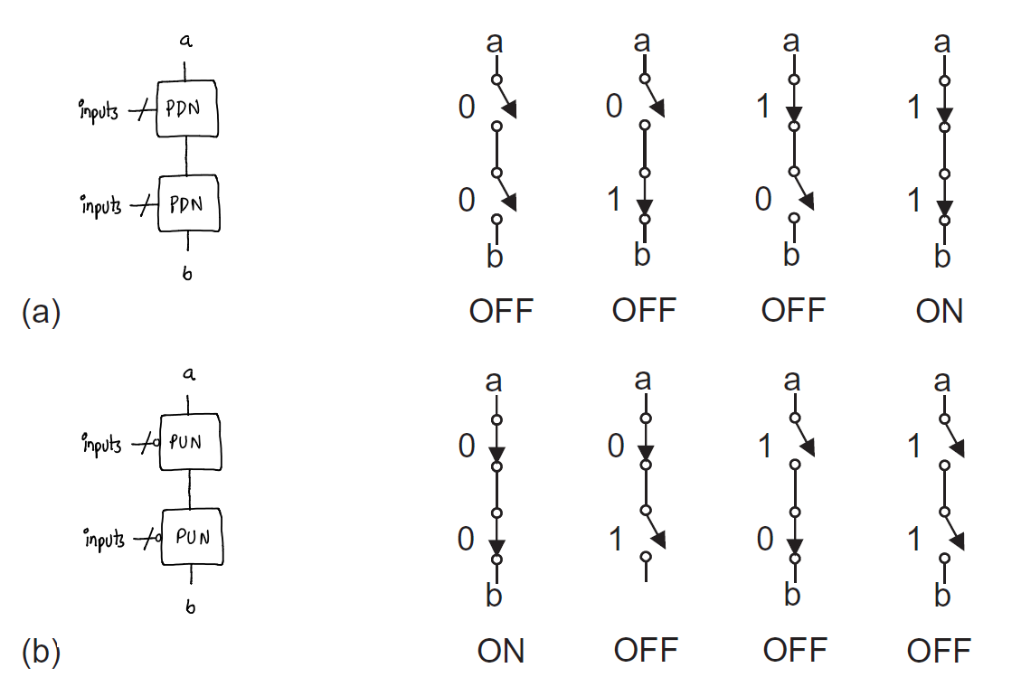
Series and Parallel Networks: General case 1
Pull-up network: multiple pMOS transistors
series combination
Low voltage at all gate inputs: ON
parallel combination
Low voltage at minimum one gate input: ON
Pull-down network: multiple nMOS transistors
series combination
High voltage at all gate inputs: ON
parallel combination
High voltage at minimum one gate input: ON
Series combination of such networks
Every network must be ON to make the whole network conducting

Slide 23
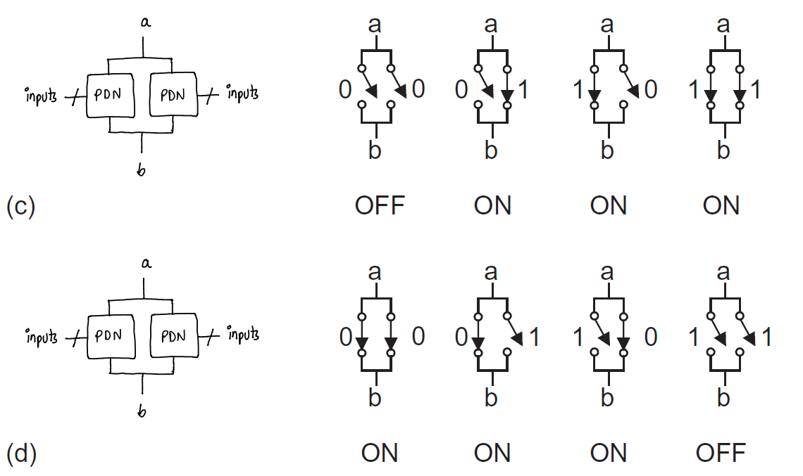
Series and Parallel Networks: General case 2
Pull-up network: multiple pMOS transistors
series combination
Low voltage at all gate inputs: ON
parallel combination
Low voltage at minimum one gate input: ON
Pull-down network: multiple nMOS transistors
series combination
High voltage at all gate inputs: ON
parallel combination
High voltage at minimum one gate input: ON
Parallel combination of such networks
At least one network must be ON to make the whole network conducting

Slide 24
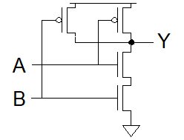
Conduction Complement
Rule of Conduction Complements
Pull-up network is complement of pull-down (and vice versa)
Parallel -> series, series -> parallel
Example: CMOS NAND-2 gate
Pull-down: 2 nMOS in series connection with inputs A & B
Pull-up: 2 pMOS in parallel (compliment of series) connection with the same inputs A & B
Conclusion: for any CMOS logic gate, we just need to build only one network (usually the pull-down, because its easier) and the conduction complement rule will take care of the other one!

Slide 25
Building An Inverting CMOS Logic Gate
Build the pull-down network using nMOS transistors
series nMOS transistor networks for inputs/signals that are “AND”ed
parallel nMOS transistors for inputs/signals that are “OR”ed
Build the pull-up network using pMOS transistors
Using the conduction complement rule
Parallel networks in pull-down network will be redrawn in series for pull-up network
Series networks in pull-down network will be redrawn in parallel for pull-up network
Connect the pull-up network (PUN) and the pull-down network (PDN) in series between V_{DD} and GND

Slide 26
An Example: Building the Pull-down Network
series nMOS transistor networks for inputs/signals that are “AND”ed together
parallel nMOS transistors for inputs/signals that are “OR”ed together
Example: consider the inverting function, Y = [(A+BC)D]’
Step 1: Individual PD networks for A, B, C, D inputs (simple case)
4 single nMOS transistors
Step 2: PD network for BC signal
B & C ANDed in BC: B & C PD networks will be in series
Step 3: PD network for (A+BC) signal
A and BC ORed (A+BC): A & BC PD networks will be in parallel
Step 4: PD network for (A+BC)D signal
(A+BC) and D ANDed in (A+BC)D: (A+BC) & D PD networks will be in series
(The term “signal” is used to describe an intermediate value which are generated from inputs. Here A,B,C,D are inputs but A+BC or BC are referred to as signal)

Slide 27
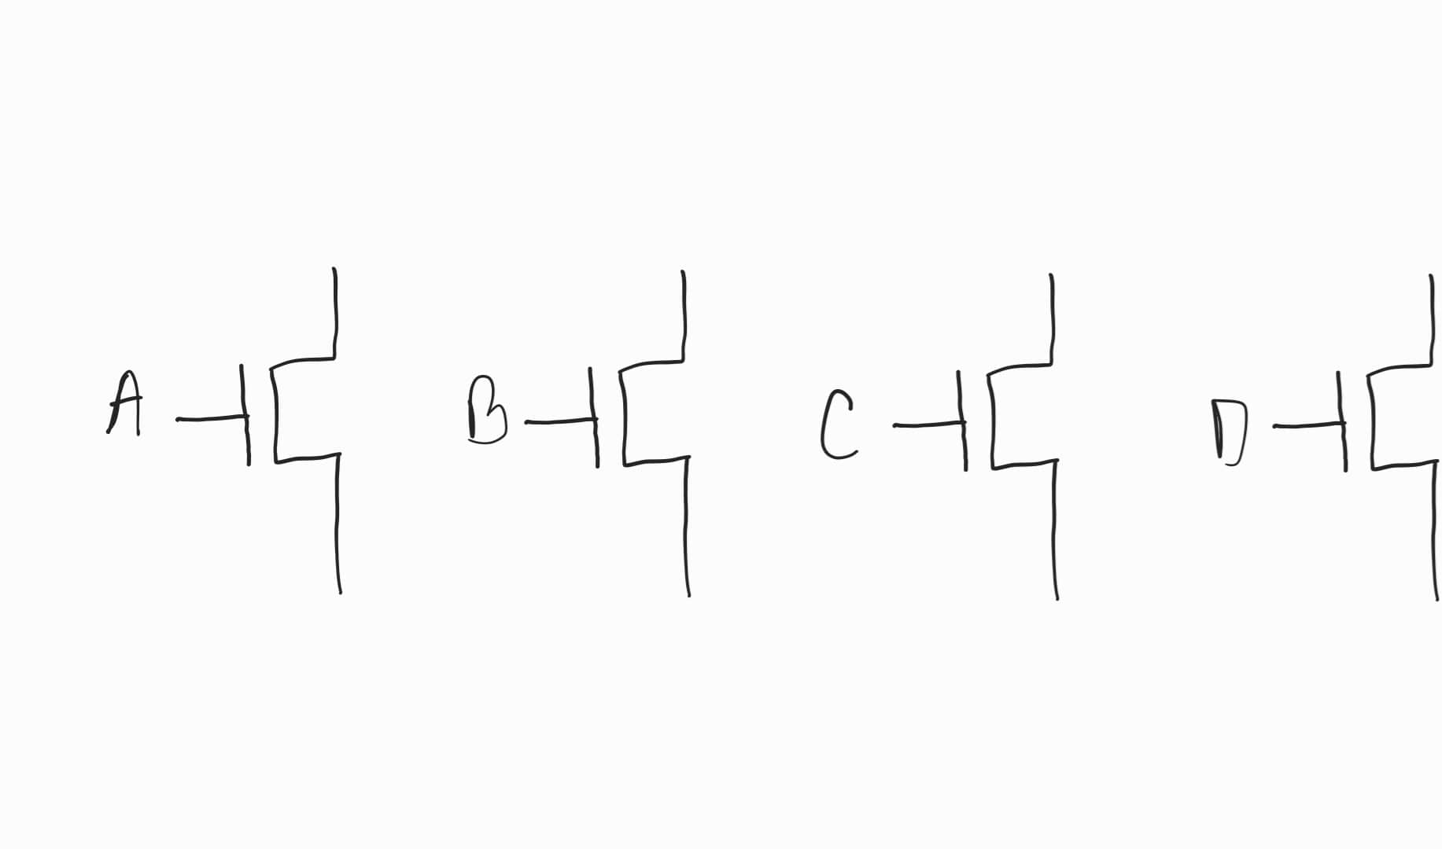
An Example: Building the Pull-down Network
Y = [(A+BC)D]’
Step 1: Individual PD networks for A, B, C, D inputs (simple case)
4 single nMOS transistors

Slide 28
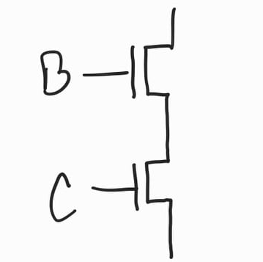
An Example: Building the Pull-down Network
Y = [(A+BC)D]’
Step 2: PD network for BC signal
B & C ANDed in BC: B & C PD networks will be in series

Slide 29
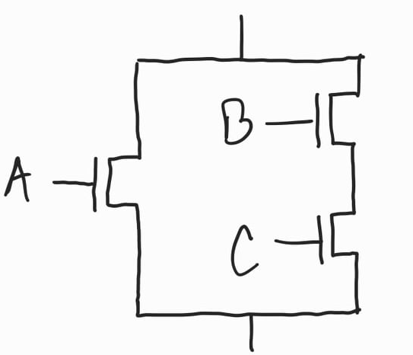
An Example: Building the Pull-down Network
Y = [(A+BC)D]’
Step 3: PD network for (A+BC) signal
A and BC ORed (A+BC): A & BC PD networks will be in parallel

Slide 30
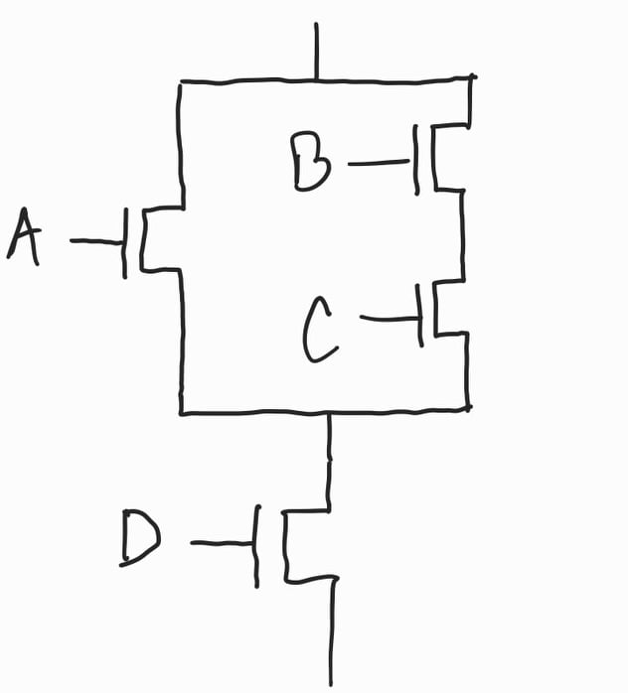
An Example: Building the Pull-down Network
Y = [(A+BC)D]’
Step 4: PD network for (A+BC)D signal
(A+BC) and D ANDed in (A+BC)D: (A+BC) & D PD networks will be in series

Slide 31
Building the Pull-up Network
Just follow the CONDUCTION COMPLEMENT rule!!
Use pMOS transistors instead of nMOS
Parallel networks in pull-down network will be redrawn in series for pull-up network
Series networks in pull-down network will be redrawn in parallel for pull-up network

Slide 32
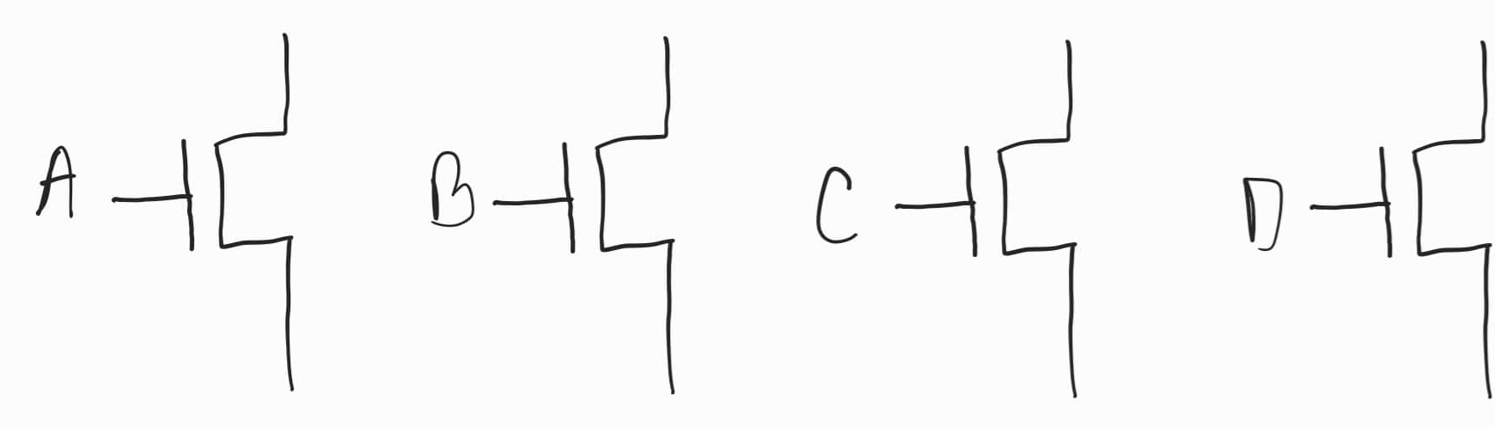
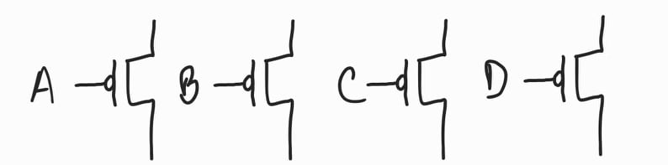
An Example: Building the Pull-up Network
Y = [(A+BC)D]’
Step 1: Individual PU networks for A, B, C, D inputs (simple case)
4 single pMOS transistors

Slide 33
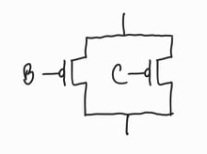
An Example: Building the Pull-up Network
Y = [(A+BC)D]’
Step 2: PU network for BC signal
B & C PD networks was in series
B & C PU networks will be in parallel

Slide 34
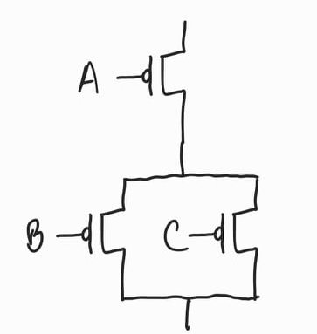
An Example: Building the Pull-up Network
Y = [(A+BC)D]’
Step 3: PU network for (A+BC) signal
A & BC PD networks was in parallel
A & BC PU networks will be in series

Slide 35
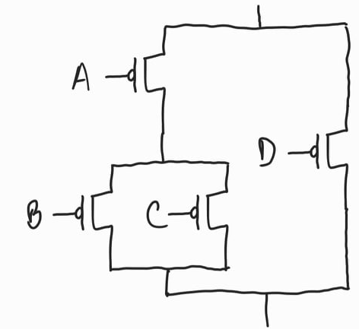
An Example: Building the Pull-up Network
Y = [(A+BC)D]’
Step 4: PU network for (A+BC)D signal
(A+BC) & D PD networks was in series
(A+BC) & D PU networks will be in parallel

Slide 36
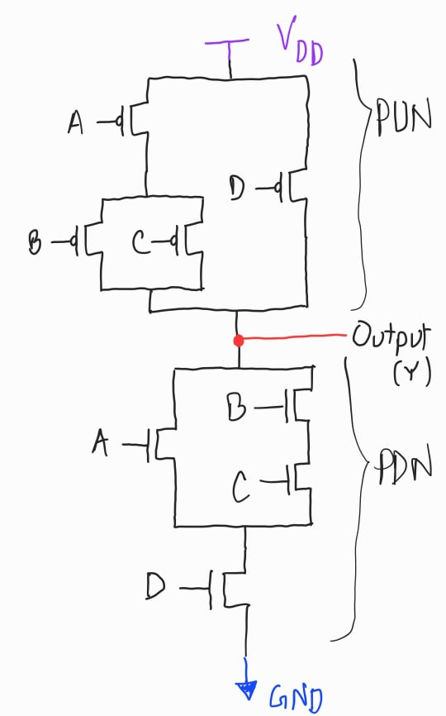
An Example: Putting it all together
Y = [(A+BC)D]’
Connect the pull-up network (PUN) and the pull-down network (PDN) in series between V_{DD} and GND
The Output of the inverting function (Y) is taken from the common node of PUN and PDN
This is the CMOS logic gate for the given inverting logic function Y

Slide 37
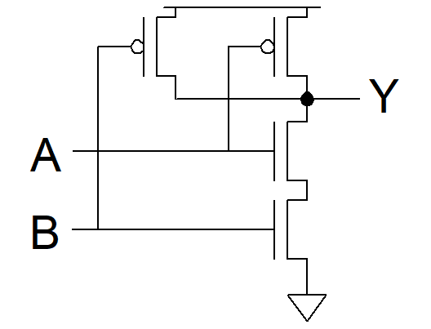
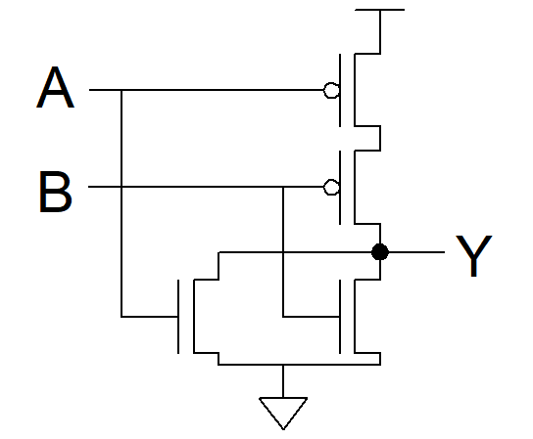
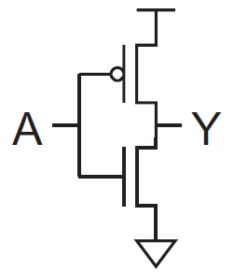
Example: CMOS NAND-2, NOR-2 and Inverter Gates
NAND-2 [ Y=(AB)’ ] NOR-2 [ Y=(A+B)’ ] Inverter [ Y=A’] logic functions can also be implemented in CMOS like this (try yourself first):

Slide 38
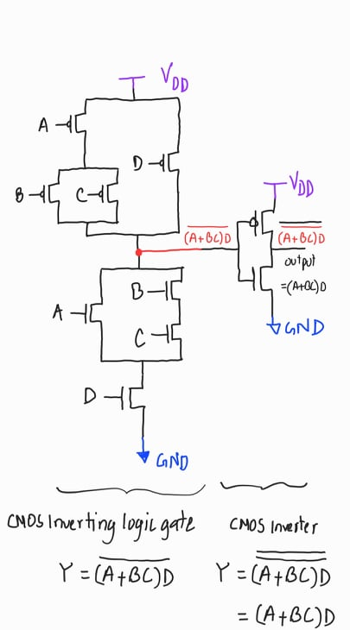
Implementing non-inverting logics in CMOS
The techniques described so far can only be applied to build any inverting logic function
There are multiple ways to implement non-inverting logic functions using CMOS
The easiest way is to use an additional inverter at the output of the inverting function
Example: Y = (A+BC)D can be build like this
Build a CMOS logic gate for Y = [(A+BC)D]’
Connect the output of the previous gate to the input of an CMOS inverter
The output of the inverter will be Y = (A+BC)D

Slide 39
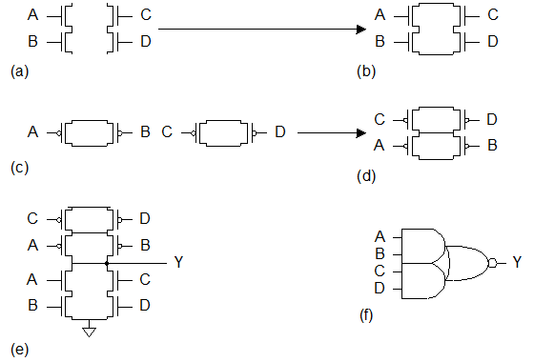
Example: CMOS AOI22 Gate
Y = (AB+CD)’ also called the AND-OR-INVERT-2-2 or AOI22 GATE

Slide 40
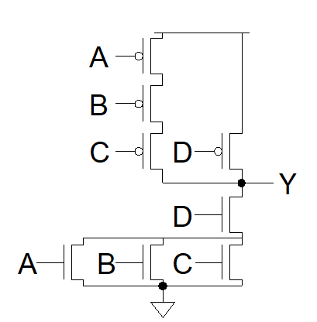
Final Example: CMOS OAI31 Gate
Y = [(A+B+C)D]’ also called the OR-AND-INVERT-3-1 or OAI31 GATE

Slide 41
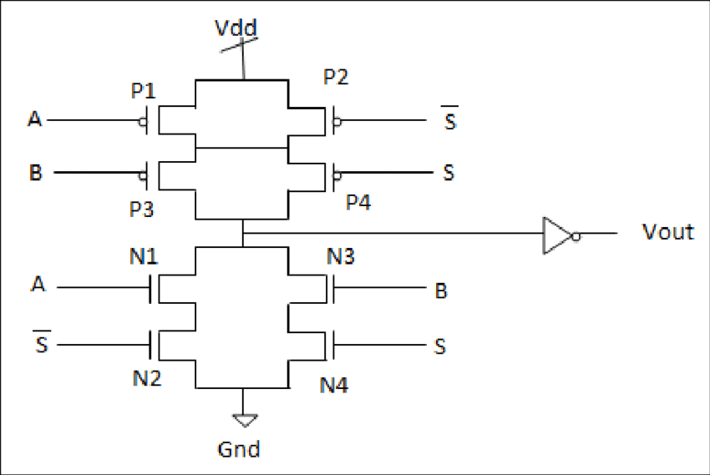
Final Example: CMOS Implementation of 2x1 MUX using
Y = S’A + SB
How many transistors required?

Slide 42
Thank you!

